Slide 1
PHP LANDING PAGE LECTURE 2
ADNAN MAJEED
LECTURER

Slide 2
INDEX.PHP
<!DOCTYPE html>
<html lang="en">
<head>
<meta charset="UTF-8">
<meta name="viewport" content="width=device-width, initial-scale=1.0">
<title>Landing Page</title>
<link rel="stylesheet" href="style.css">
</head>
<body>
<header>
<div class="header-content">
<h1>Welcome to Our Website</h1>
<p>Get the latest updates directly to your inbox.</p>
<form action="process_form.php" method="POST">
<input type="email" name="email" placeholder="Enter your email" required>
<button type="submit">Subscribe</button>
</form>
</div>
</header>

Slide 3
<section class="features">
<h2>Our Features</h2>
<div class="feature-list">
<div class="feature-item">
<h3>Feature 1</h3>
<p>Brief description of Feature 1.</p>
</div>
<div class="feature-item">
<h3>Feature 2</h3>
<p>Brief description of Feature 2.</p>
</div>
<div class="feature-item">
<h3>Feature 3</h3>
<p>Brief description of Feature 3.</p>
</div>
</div>
</section>
<footer>
<p>&copy; <?php echo date("Y"); ?> Your Website. All rights reserved.</p>
</footer>
</body>
</html>

Slide 4
STYLE.CSS
* {
margin: 0;
padding: 0;
box-sizing: border-box;
font-family: Arial, sans-serif;
}
body {
display: flex;
flex-direction: column;
min-height: 100vh;
background-color: #f4f4f4;
}
header {
background: #008cba;
color: white;
padding: 60px 20px;
text-align: center;
}
.

Slide 5
header-content h1 {
font-size: 2.5rem;
margin-bottom: 10px;
}
.header-content p {
font-size: 1.2rem;
margin-bottom: 20px;
}
form {
display: flex;
justify-content: center;
}
input[type="email"] {
padding: 10px;
font-size: 1rem;
width: 250px;
margin-right: 10px;
border: 1px solid #ddd;
border-radius: 5px;
}

Slide 6
button {
padding: 10px 20px;
font-size: 1rem;
color: white;
background: #005f8d;
border: none;
border-radius: 5px;
cursor: pointer;
}
button:hover {
background: #004466;
}
.features {
padding: 40px 20px;
background-color: #ffffff;
text-align: center;
}
.features h2 {
margin-bottom: 20px;
font-size: 2rem;
}
.

Slide 7
feature-list {
display: flex;
justify-content: center;
gap: 20px;
flex-wrap: wrap;
}
.feature-item {
width: 200px;
padding: 20px;
background-color: #f9f9f9;
border: 1px solid #ddd;
border-radius: 5px;
}
footer {
background-color: #333;
color: white;
text-align: center;
padding: 10px 0;
margin-top: auto;
}

Slide 8
Process_form.php
<?php
if ($_SERVER["REQUEST_METHOD"] == "POST") {
$email = filter_var($_POST['email'], FILTER_SANITIZE_EMAIL);
if (filter_var($email, FILTER_VALIDATE_EMAIL)) {
// Save email to a file or database (basic example uses a file)
$file = 'subscribers.txt';
file_put_contents($file, $email . PHP_EOL, FILE_APPEND | LOCK_EX);
echo "<p>Thank you for subscribing! We've received your email: $email.</p>";
} else {
echo "<p>Invalid email address. Please try again.</p>";
}
} else {
echo "<p>Invalid request. Please go back to the landing page.</p>";
}
?>

Slide 9
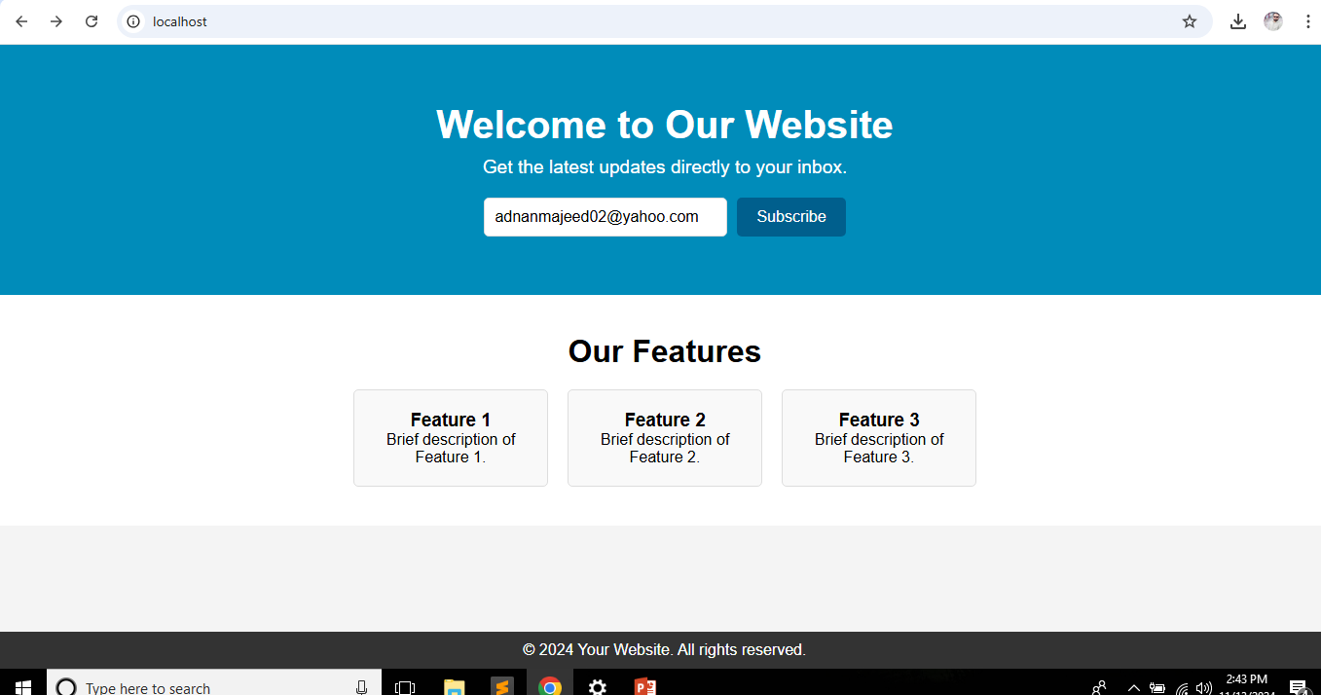
Output

Slide 10


